Slide 1
EMBASSY OF INDIA
Caracas, Venezuela
Omar Molina Fereira
Marketing Assistant
Caracas, March, 2014
INDIA-VENEZUELA
TRADE PROSPECTS IN AUTOPARTS

Slide 2
INDIA AS A PARTNER COUNTRY
Why are Global Investors
investing in India?
1.25 BN
2nd
Largest
population
worldwide
100 M
2nd
Largest pool of Certified Professionals and Qualified Engineers in the world
3rd
Largest GDP (PPP)
(2013)
3rd
Largest investor base in the World
10th
10th largest GDP (Nominal
US$ 1.8 trillion )

Slide 3
REASONS FOR BOOMING AUTO INDUSTRY
Why are Global Investors
investing in India?
One of the fastest
Growing Economies Estimates for 2012-13: 5%
India’s average
GDP growth rate: 8.4% over past 5 years
Demographics
Advantage
Youth driven economy
Suburbanization & Rural to Urban Migration
140 million by 2020; 700 million by 2050
Robust Legal and Banking Infrastructure

Slide 4
REASONS FOR BOOMING AUTO INDUSTRY
Why are Global Investors
investing in India?
India is poised to be one of the fastest growing automotive markets worldwide over the next decade and is slated to move from number 6 position to number 3 position in the passenger vehicle market

Slide 5
REASONS FOR TRADING WITH INDIA
You can source your requirements from India because:
If you directly import from India, procurement cost will no doubt be cheaper
Indian manufacturers focus on quality
Assembled vehicles
can be exported to other Latin American countries
You can also set up
assembly plants
for Indian for two wheelers, three wheelers and four wheelers in Venezuela
Even renowned internationational brands
are sourcing their requirements from India

Slide 6
INDIA AUTO COMPONENT PRODUCT RANGE
During year 2012
Source: ACMA

Slide 7
INDIAN AUTOMOTIVE PRODUCTION
No. of Units
Source: ACMA

Slide 8
INDIAN AUTOMOTIVE PRODUCTION
No. of Units
Source: ACMA

Slide 9
INDIAN EXPORTS
2012-13 Mn USD
Total Indian Exports in 2012
US$ 300.400 Bn
Vehicles and parts Exports
US$ 12.193 Bn
Which represents 4,05% of total exports

Slide 10
WHICH COMPONENTS CAN INDIA
SUPPLY TO YOU
Engines
Pistons & Piston rings
Tyres
Transmission belts
Fuel injection equipment
Vacuum Brake Hose & Radiator
Seals and Gaskets
Glass Mirrors
Oil filters
Screw & Bolts
Crank shaft
Gears & clutches
Clutch & shaft
Distribution and ignition coils
Head lamps, tail lamps, stop lamps
Steering wheels
Any other item you would like to import

Slide 11
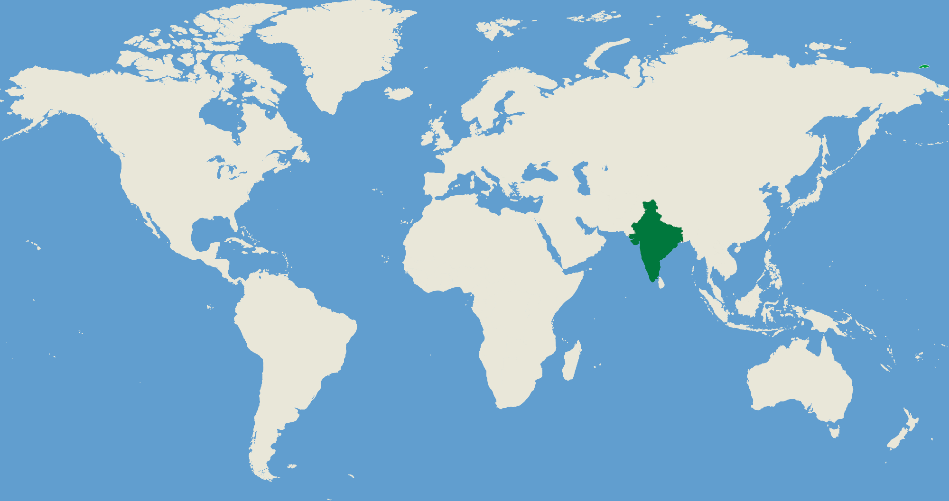
INDIAN EXPORTS
Indian vehicles and parts
Exports Destinations, 2012
INDIA IS AIMING FOR NEWER MARKETS
35.6%
24%
24.3%
6.6%
8.6%
0.9%
INDIAN AUTOMOBILE COMPONENTS ARE EXPORTED TO MORE THAN 200 COUNTRIES ALL OVER THE WORLD
Source: ACMA

Slide 12
INDIAN EXPORTS OF AUTOPARTS
2012 - Mn US$
2012-13
US$ 33.9 BN
2015-16 (target)
US$ 54 BN
2020-21 (target)
US$ 85 BN
Source: ACMA

Slide 13
VENEZUELA IMPORTED
2012 - Mn US$
Total imports
US$ 47.310 BN
Vehicles and autoparts
US$ 1.886 BN
India’s share
US$ 239.119,88
Which is only 0,01% of imports of vehicles and autoparts. This represents a great opportunity for trade with India

Slide 14
VENEZUELA IMPORTED
2012 - Mn US$
Total Imports of Vehicles, Tractors, Motorcycles, Velocipedes and other
Land Vehicles, Parts and Accesories
US$ 1.886.075.279,20
Pos.
Top Exporters to Venezuela 2012
Share %
1
China
38.92 %
2
USA
17.38 %
3
Ecuador
11.21 %
4
Brazil
8.87 %
5
Argentina
8.63 %
36
India
US$ 239.119,88 = 0.01%
Source: Estadísticas de Comercio Exterior – Instituto Nacional de Estadística (INE) Venezuela

Slide 15
VENEZUELA IMPORTED
2012 - Mn US$
Total Imports of Parts And Accessories for Automotive Vehicles, Tractors, Passenger Transportation, Motorcycles
US$ 427.631.528,84
Pos.
Top Exporters to Venezuela 2012
Share %
1
USA
38.33 %
2
China
24.40 %
3
Brazil
7.37 %
4
Colombia
5.49 %
5
Panama
4.97 %
28
India
US$ 226.101,49 = 0.05%
Source: Estadísticas de Comercio Exterior – Instituto Nacional de Estadística (INE) Venezuela

Slide 16
VENEZUELA IMPORTED
2012 - Mn US$
Total Imports of Bicycles And Other Velocipes
US$ 29.944.092,28
Pos.
Top Exporters to Venezuela 2012
Share %
1
China
83.66 %
2
Panama
7.32 %
3
Hong Kong
2.53 %
4
USA
2.31 %
5
Taiwan
1.70 %
36
India
13.018,39 USD = 0.04%
Source: Estadísticas de Comercio Exterior – Instituto Nacional de Estadística (INE) Venezuela

Slide 17
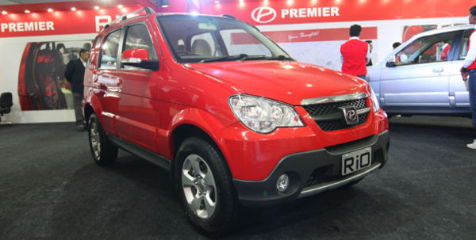
INDIAN CAR MANUFACTURERS
Premier Limited – RiO SUV

Slide 18
INDIAN CAR MANUFACTURERS
TATA Motors – Manza Sedan

Slide 19
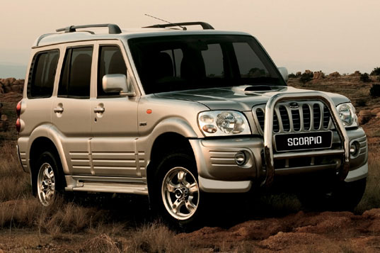
INDIAN CAR MANUFACTURERS
Mahindra – Scorpio SUV

Slide 20
INDIAN CAR MANUFACTURERS
Force Motors – Force One

Slide 21
INDIAN CAR MANUFACTURERS
ICML – Extreme VD

Slide 22
INDIAN CAR MANUFACTURERS
Ashok Leyland – DOST

Slide 23
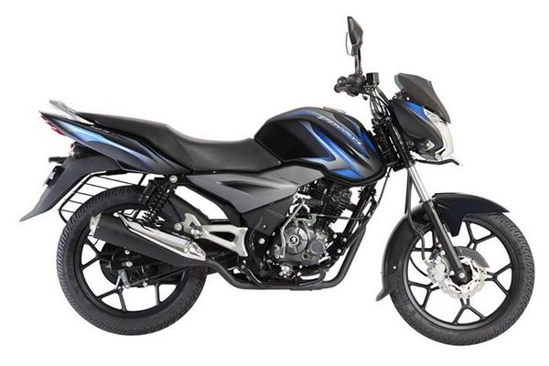
INDIAN CAR MANUFACTURERS
Bajaj – Discover 125T

Slide 24
MAIN GLOBAL OEM IN INDIA

Slide 25
TIER 1 COMPONENT MANUFACTURERS IN INDIA

Slide 26
INDIAN EXPORT PROMOTION BODIES
Automotive Component Manufacturers Association of India (ACMA)
Address: The Capital Court 6th Floor, Olof Palme Marg
Munirka New Delhi 110 067 Tel : +91-11-26160315
Fax : +91-11-26160317 Email: acma@acma.in
Website : www.acma.in

Slide 27
INDIAN EXPORT PROMOTION BODIES
Society of Indian Automobile Manufacturers (SIAM)
Address: Core 4-B, 5th Floor,
India Habitat Centre Lodhi Road, New Delhi – 110 003, India
Tel : +91-11-24647810 -12 Fax: +91-11-24648222
Email : siam@siam.in
Website : http://www.siamindia.com

Slide 28
FOR ASSISTANCE
Please contact:
Embassy of India
Email: amb.caracas@mea.gov.in
com.caracas@mea.gov.in
comercial@embindia.org
Tel: 0212 288 78 87

